Slide 1

Aws Secrets Manager
Author: Jerry Luong
Position: Software Developer Intern

Slide 2

An Existing Problem:
Secrets of our customers are stored explicitly in the code and any developers working for the company can see those secrets.
What if developers save and copy those secrets and use them maliciously when they leave the company.

Slide 3
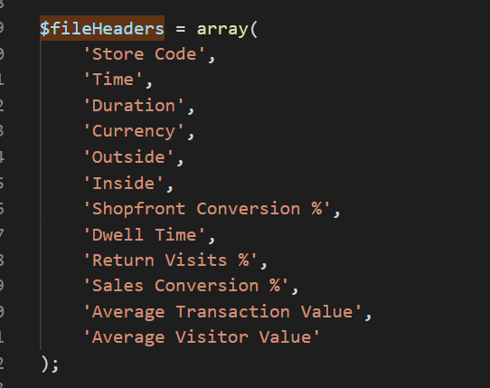

An example for our existing problem
- Telstra is one of our customers.
-

Slide 4
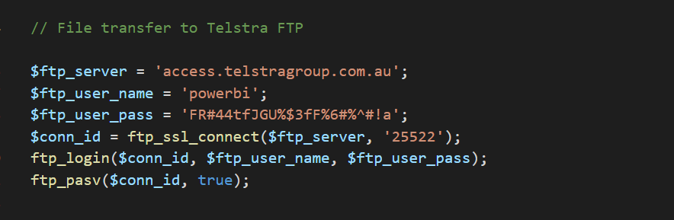

Example:
- We transfer the file to Telstra through File Transfer Protocol.
- What if we only wants developers to access to those secrets in a short period of time when they are actually in need of them, not permanently ?

Slide 5

Found solution: hiding secrets on Aws Secrets Manager.
Create a new secret key and provide its values on Aws.
Rotate Secrets (no code implementations today).
Apply IAM (no code implementations today).
Developers retrieve Secrets.

Slide 6
CREATE A NEW SECRET KEY
What do we get after this step:
The Secret Name that developers will use to retrieve secrets.

Slide 7
IAM Policy For Aws Secrets Manager
Questions:
Who are granted secrets ?
What can they do with the given secrets ?

Slide 8








IAM Policy for Aws Secrets Manager
Example1:

Slide 9
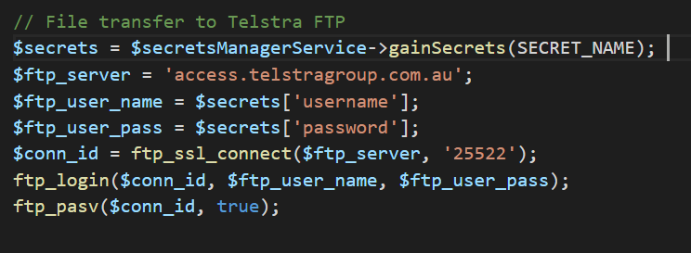


RETRIEVE SECRETS
Before applying Aws Secrets Manager
After applying Aws Secrets Manager

Slide 10
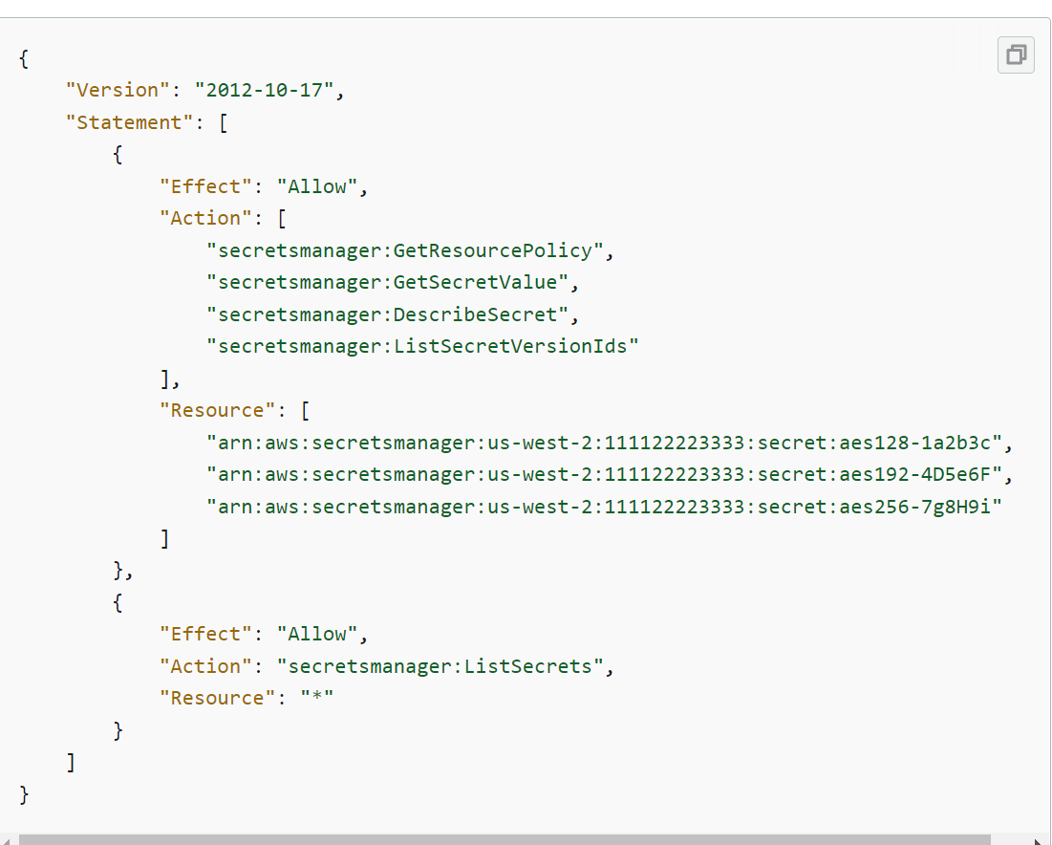
IAM Policy for Aws Secrets Manager
Example 2:

Slide 11


TIME FOR YOUR QUESTIONS !!!

